Slide 1


From Worry To Happiness
Lesson 3
Wednesday Night
Bible class
Palm Beach Lakes
church of Christ

Slide 2

From Worry To Happiness
Lesson 3
Worry

Slide 3
From Worry To Happiness
Lesson 3
Class Objectives
Understand our God given emotions.
Understand the nature of God.
Gain coping skills and move toward happiness

Slide 4
From Worry To Happiness
Lesson 3
Key Take Away
Our feelings come from our brains taking in
outside stimuli and trying to handle what is coming in.
So, WE DO NOT have to be mad at the driver that
cuts us off on the highway.

Slide 5
From Worry To Happiness
Lesson 3
Key Take Aways From Achan
1. There is a consequence for sin.
2. God is omniscient.
3. Sin does not stay put.

Slide 6
From Worry To Happiness
Lesson 3
Key Take Aways From Feeling Something Is Right
Paul thought he was right when he persecuted Christians.
King Saul
* Thought he was right when he offered sacrifices. 1 Samuel 13
* Thought he was right when he didn’t destroy everything. 1 Samuel 15
* You could say King Saul has Ongoing Self- Justification.

Slide 7
From Worry To Happiness
Lesson 3
Problems with guilt
So many suffer from guilt that do not
need to.
2. Others do not feel guilt and should.

Slide 8
From Worry To Happiness
Lesson 3
Forgiveness must be more than a feeling
1. We regulate forgiveness to a “feeling”
Forgiveness is a condition.
Jesus died for our “saved condition”

Slide 9
From Worry To Happiness
Lesson 3
This is our awesome God
But know, thus says the Lord, who created you, O Jacob:
And He who formed you, O Israel:
“ Fear not, for I have redeemed you;
I have called you by your name;
You are mine.” Isaiah 43: 1

Slide 10
From Worry To Happiness
Lesson 3
Consequences of Guilt
Bad self esteem
Problems in marriage & other relationships
Self punishment
Unproductive life
Unproductive spiritual life

Slide 11
From Worry To Happiness
Lesson 3
Causes of Guilt
Sin
Conditioning
The Bible talks about proper conditioning
in Proverbs 22:6.
3. We can be conditioned for guilt.

Slide 12
From Worry To Happiness
Lesson 3
The Answer to Guilt
The answer is Jesus. Isaiah 53:5 , Jeremiah 31:34
Titus 2:4, 1 Peter 1: 18-19
Jesus died for us. God does not remember sin.
We are raised in newness of life.
We are redeemed.

Slide 13
From Worry To Happiness
Lesson 3
Bottom line On Guilt
1. Guilt is good. It can bring one to repentance.
Holding on to guilt is bad, and can lead to all kinds
wrong in your life that does not need to be there.

Slide 14

From Worry To Happiness
Lesson 3
Dealing With Regret
The thief on the cross. Luke 23:43
Did he have regrets? Did his regrets bring him to
a relationship with Jesus?

Slide 15
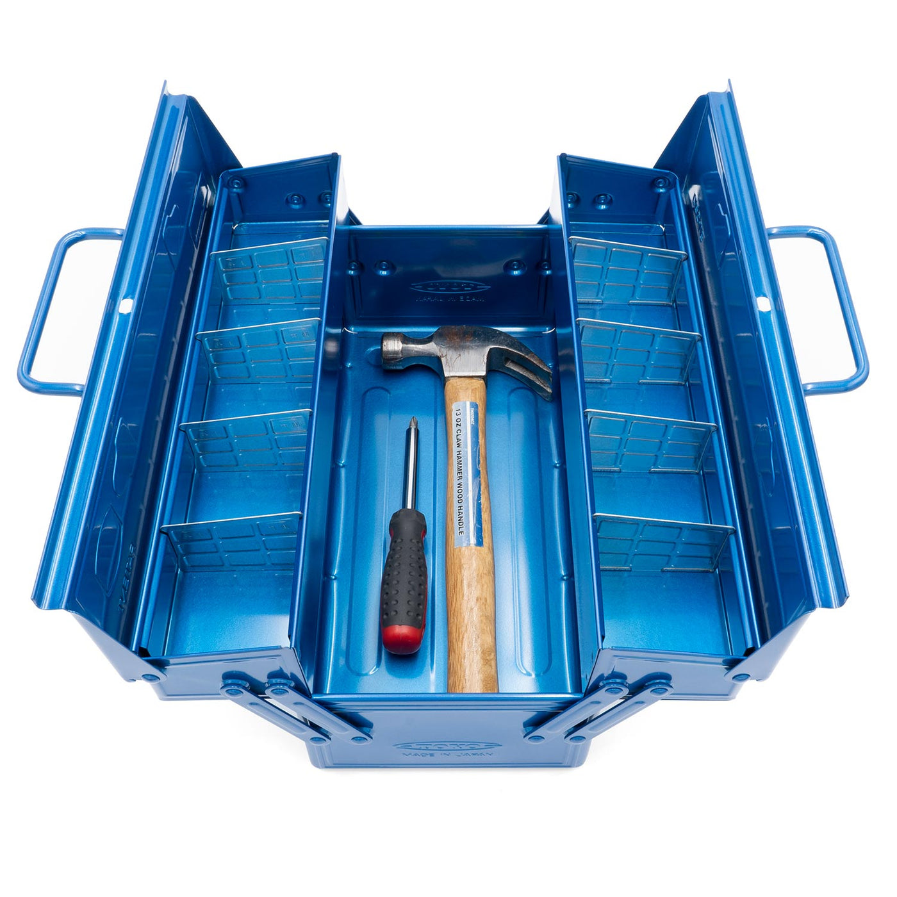
From Worry To Happiness
Lesson 3
What Is In Your Toolbox ?

Slide 16

From Worry To Happiness
Lesson 3
Worry

Slide 17
From Worry To Happiness
Lesson 3
What we worry about
Our future 5. Acceptance 9. Possessions
Our marriage 6. Approval 10. Family
Our relationships 7. Our salvation
Our jobs 8. Our homes

Slide 18

From Worry To Happiness
Lesson 3
Article From Kyle Butt, Apologetics Press
Worry has …….
- Caused countless cost in the health care profession.
- Crippled the effectiveness of Christians.
- Led to premature death of loved ones.
- Separated souls from God.

Slide 19
From Worry To Happiness
Lesson 3
Not all concerns are bad
“My car needs an oil change” 6. “A pet tiger escaped”
“The tire just blew out” 7. “The ladder is wobbly”
“There is a shark just offshore”
“My co-worker is not saved”
“The tub is overflowing”

Slide 20
From Worry To Happiness
Lesson 3
Worry
Matthew 6:34
1 Peter 5:7
Philippians 4:6-7
Isaiah 41:10
Proverbs 3:5-6

Slide 21
From Worry To Happiness
Lesson 3
Over Coming Worry
From the Mayo Clinic:
“The best way to control anxiety is to make use of the
opposite side of the brain. While anxious thoughts
occur in one half of our brain, thoughts of gratitude
occur in the other.”

Slide 22
From Worry To Happiness
Lesson 3
Over Coming Worry
1. Analysis
*Analize the situation you are worried about
2. Pray, pray, and pray some more
3. Action
* Take appropriate action. Plan to succeed.

Slide 23
From Worry To Happiness
Lesson 3
Over Coming Worry
4. Acceptance
*Somethings can not be changed.
5. Service
*Great strength in looking outward
*Romans 12: 1,2
6. Trust in the Lord

Slide 24
From Worry To Happiness
Lesson 3
Bible Examples Of Dealing With Worry
1. Rich young ruler- Mark 10:17-22
2. Hannah- 1 Samuel 1
3. Hannah’s song of thanksgiving can be found
in 1 Samual 2: 1-10

Slide 25
From Worry To Happiness
Lesson 3
Solution to Worry
The solution to worry comes through analysis,
prayer, action, acceptance, service, and trust.
Our lives may be permanently altered, but do not
have to be wrecked

Slide 26
From Worry To Happiness
Lesson 3
Solution to Worry
Galatians 6:5- You have some burdens that only you
can bear.
Galatians 6:2 - You have some burdens that others
can help you bear.
Psalm 55:22 - Some burdens you need to cast on the Lord.

Slide 27
From Worry To Happiness
Lesson 3
Step 1
Create a “worry diary” . Write down your worries.
Observe with out judgement. Acknowledge the worry’s
presence without immediately reacting or judging
yourself for it.

Slide 28
From Worry To Happiness
Lesson 3
Step 2
Controllable worries (actionable)
a. Ask yourself “ What can I do about this?”
b. Gather the facts: Don’t jump to conclusions.
c. Brainstorm solutions.
d. Create an action plan: Decide a course of action

Slide 29
From Worry To Happiness
Lesson 3
Step 3
Uncontrollable worries ( non-actionable)
a. Identify the lack of control: The situation is out of your hands.
b. Practice acceptance: Uncertainty is a part of life.
c. Redirect your focus: Turn to things that you can recognize

Slide 30
From Worry To Happiness
Lesson 3
Step 4
Examine your thoughts
a. Question the assumptions
b. Consider alternative perspectives
c. Assess the likelihood.

Slide 31
From Worry To Happiness
Lesson 3
For every problem under the sun
there is a solution, or there is none.
If there is a solution, go and find it.
If there is none, then never mind it.
From an article by Sam Wilcut, Carriage Road church of Christ

Slide 32
From Worry To Happiness
Lesson 3
Identify unhelpful thinking patterns
Catastrophizing: Expecting the worse of the worse.
Emotional reasoning: Believing that because
you feel something, it must be true.
c. Seeing things with no middle ground.

Slide 33
From Worry To Happiness
Lesson 3
Catastrophic Thinking
“Catastrophic thinking is a cognitive distortion that occurs when people have a hard time weighing the likelihood of certain outcomes and believe that terrible or catastrophic outcomes—which are highly unlikely—become, in one’s mind, salient and extremely likely,” Dr. Zaubler explained, noting “it can lead to a lot of suffering.”
Dr. Zauber , Psychiatrist, MD, MPH

Slide 34
From Worry To Happiness
Lesson 3
Catastrophic Thinking
The biology of catastrophic thinking involves overactivity in brain regions like the amygdala (fear center) and thalamus, linked to heightened threat sensitivity and pain processing, driven by neurochemical releases that create a fear/stress response, strengthening neural pathways for negative spirals, often rooted in past trauma or anxiety, making the brain learn to expect the worst.

