Slide 1


From Worry To Happiness
Lesson 2
Wednesday Night
Bible class
Palm Beach Lakes
church of Christ

Slide 2

From Worry To Happiness
Lesson 2
How to Handle Guilt Feelings

Slide 3
From Worry To Happiness
Lesson 2
Class Objectives
Understand our God given emotions.
Understand the nature of God.
Gain coping skills and move toward happiness

Slide 4
From Worry To Happiness
Lesson 2
Why are we on the Earth ?
Isaiah 43:7
“Everyone who is called by My name, Whom
I have created for My glory; I have formed
him, yes, I have formed him.”

Slide 5
From Worry To Happiness
Lesson 2
A. Percent of adults with regular feelings of worry, nervousness,
or anxiety. – 12.5%
Percentage of adults with regular depression. – 5%
Percentage of doctor visits with Mental Disorder diagnosis. – 57%
Number of suicides. 2024 Data – 48,821

Slide 6
From Worry To Happiness
Lesson 2
The Human Brain
At every moment, our brain orchestrates a
complex symphony of perfectly coordinated
signals across billions of neurons and
trillions of synapses.

Slide 7
From Worry To Happiness
Lesson 2
Pattern of Stress & Worry in The Bain
1st The Amygdala detects a threat.
2nd Amygdala sends an alarm to other parts of the brain.
3rd The Hypothalamus relays the signal to the brain’s
stress response system.

Slide 8
From Worry To Happiness
Lesson 1
Pattern of Stress & Worry In The Brain
4th The brain releases Cortisol and Adrenaline.
5th The body’s organs respond to the hormones, increasing
heart rate and breathing rate.
6th The brain attempts to put the threat into context by
drawing on past experiences.

Slide 9
From Worry To Happiness
Lesson 2
The Bible Has The Answers
Marriages The Boss Good works
Parenting Employees Abstaining from evil
Friends Siblings Stewardship
Enemies Fellow Christians Salvation

Slide 10
From Worry To Happiness
Lesson 2
The Bible Has The Answers
Guilt Worry Grief
Sorrow Anxiety Insecurities
Joy Fear Sin
Hate Discouragement Love

Slide 11
From Worry To Happiness
Lesson 2
Our brain can produce False Memories
*National Center for Biotechnology Information
*Cognitive Neuroscience Society
*Association of Psychological Science
*National Institute of Health

Slide 12
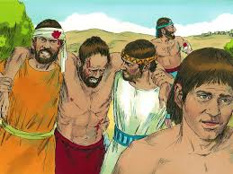
From Worry To Happiness
Lesson 2
What we feel can be wrong and deceiving.
Joshua chapter 7 Achan’s desire was wrong

Slide 13
From Worry To Happiness
Lesson 2
What we feel can be wrong and deceiving
Having a “feeling” is different than following
the truth.
Salvation is too important of a subject to depend on
a feeling. It must be according to God’s word.
Jeremiah 17:9

Slide 14
From Worry To Happiness
Lesson 2
From the author
“Cognitive restructuring of the mind goes deeper than mere
intellectual assent. We need to learn and internalize vital
principles until they become second nature to us. Such
changes will produce a life of happiness and productivity.”
From Worry to Happiness- Bill W. Flatt

Slide 15
From Worry To Happiness
Lesson 2
Take Away from Last Week
Our feelings come from our brain taking in outside stimuli and trying to handle what is coming in.
So, WE DO NOT have to be mad at the driver that cuts us off on the highway.

Slide 16
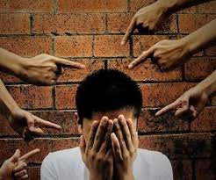
From Worry To Happiness
Lesson 2
How to Handle Guilt Feelings
Regret and Addiction

Slide 17
From Worry To Happiness
Lesson 2
Guilt: a. the state of one who has committed an offense
especially consciously.
b. feelings of deserving blame especially for imagined
offenses or from a sense on inadequacy.

Slide 18
From Worry To Happiness
Lesson 2
Problems with guilt
So many suffer from guilt that do not
need to.
2. Others do not feel guilt and should.

Slide 19
From Worry To Happiness
Lesson 2
We can be entrapped in “bothered conscience”
The problem for many is accepting God’s forgiveness.
Guilt can be defined as: A subjective feeling of
responsibility for wrongdoing, for sin.
When we ask God for forgiveness, the feeling of guilt
needs to be set aside.
E. Degrees of guilt.

Slide 20
From Worry To Happiness
Lesson 2
Forgiveness must be more than a feeling
1. We regulate forgiveness to a “feeling”
Forgiveness is a condition.
Jesus died for our “saved condition”

Slide 21
From Worry To Happiness
Lesson 2
Consequences of Guilt
Bad self esteem
Problems in marriage & other relationships
Self punishment
Unproductive life
Unproductive spiritual life

Slide 22
From Worry To Happiness
Lesson 2
Consequences of Guilt
Esau (Gen. 25:29-34; Hebrews 12:14-17)
Saul & David (1 Samuel 17 & 18)
David handling his guilt (Psalm 51)

Slide 23
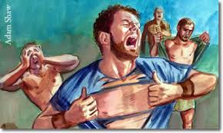
From Worry To Happiness
Lesson 2
A Deeper Look at David
David sins. (2 Samuel 11–12)
David’s sins bothered him. (Psalm 32)
David believed in deliverance. (Psalm 37)
David believed in repentance. (Psalm 51)

Slide 24
From Worry To Happiness
Lesson 2
Causes of Guilt
Sin
Conditioning
The Bible talks about proper conditioning in Proverbs 22:6.
3. We can be conditioned for guilt.

Slide 25
From Worry To Happiness
Lesson 2
The Answer to Guilt
The answer is Jesus.
  (Isaiah 53:5; Jeremiah 31:34; Titus 2:14; 1 Peter 1:18-19)
Jesus died for us. God does not remember sin.
We are raised in newness of life.
We are redeemed.

Slide 26
From Worry To Happiness
Lesson 2
Looking at Psalm 103
*Who forgives all your iniquities
*Who redeems your life from destruction
*Slow to anger and abounding in mercy
*As far as east is from west, So far has He removed our
transgressions from us.

Slide 27
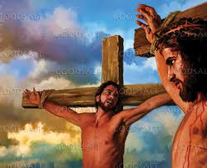
From Worry To Happiness
Lesson 2
Dealing with Regret
The thief on the cross (Luke 23:43)
Did he have regrets?
Did his regrets bring him to a relationship
with Jesus?

Slide 28
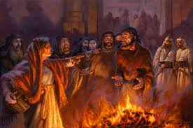
From Worry To Happiness
Lesson 2
Dealing With Regret
Peter Denies Jesus
“But he denied it before them all, saying,
I do not know what you are saying.”
Matthew 26:70

Slide 29
From Worry To Happiness
Lesson 2
The Addiction Cycle
Sin
Guilt & Regret
Repentance

Slide 30
From Worry To Happiness
Lesson 2
Addiction originates in the brain’s reward system, particularly
the nucleus accumbens. Flood of dopamine creates an intense
feeling of pleasure, motivating the brain to repeat the behavior.
Over time this disrupts the prefrontal cortex, which is responsible for
decision making, and leads to a cycle of use despite negative
consequences.

Slide 31


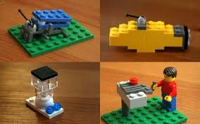
From Worry To Happiness
Lesson 2
The area of the brain that has to do with addiction, the
nucleus accumbens, also has to do with the desire to
build things, create, paint a picture etc.……

Slide 32
From Worry To Happiness
Lesson 2
IMPORTANT TONIGHT
You can not conquer your addiction by yourself.
You must have help from a person or a group of people.
Sometimes professional help.

Slide 33
From Worry To Happiness
Lesson 2
“For we do not have a High Priest who cannot sympathize
with our weaknesses, but was in all points tempted as
are, yet without sin.”
Hebrews 4:15

Slide 34
From Worry To Happiness
Lesson 2
Helpful Steps to Conquer Addiction
1. Love and community are Christian principles.
2. Prayer provides guidance.
3. God is always there for you.
4. Focus on God’s word.
James 4:7 Matthew 26:41

Slide 35
From Worry To Happiness
Lesson 2
Our feelings come from our brain taking in outside
stimuli and trying to handle what is coming in.
So, WE DO NOT have to be mad at the driver that
cuts us off on the highway.

Slide 36

From Worry To Happiness
Lesson 2
To quote one of our preachers;
Boston was right, “it’s more than a feeling”

