Slide 2


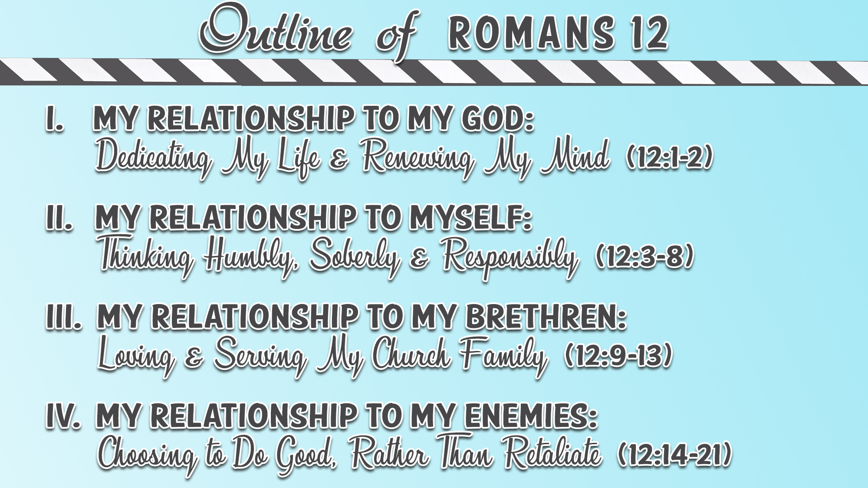

Slide 3
Choose to Do Good (12:14-16)
Bless those who persecute you (12:14)
Bless and do not curse (12:14)
Rejoice with those who rejoice (12:15)
Weep with those who weep (12:15)
Be of the same mind toward one another (12:16)
Do not set your mind on high things (12:16)
Associate with the humble (12:16)
Do not be wise in your own opinion (12:16)

Slide 4
Choose to Not Retaliate (12:17-21)
Never pay back evil for evil to anyone (12:17)
Have regard for good things in the sight of all men (12:17)

Slide 5
Choose to Not Retaliate (12:17-21)
Live peaceably with all men (12:18)
  Refusing to repay evil is refusing to inflame a quarrel
    That’s good (Prov. 17:14; 20:3), but it’s not enough! We must take the initiative toward peace!
  The Greek word means “to bring to peace, cultivate peace, keep peace, reconcile”
    The present tense emphasizes continuous effort and behavior
  The same word is used in Mark 9:50, 1 Thess. 5:13, 2 Cor. 13:11
  The object of this peace is “all men”
  The two qualifications of this peace: (1) “if possible” + (2) “as far as it depends on you”
    We cannot do what is impossible
    But, we must try…and do as much as we can

Slide 6
Choose to Not Retaliate (12:17-21)
Live peaceably with all men (12:18)
  God’s children are charged to:
    “Let the peace of God rule in your hearts” (Col. 3:15)
    “Lead a quiet and peaceable life in all godliness and reverence” (1 Tim. 2:2)
    “Be peaceable” (Tit. 3:2; cf. Jas. 3:17)
    Be “peacemakers” (Matt. 5:9; cf. Jas. 3:18)
    “Seek peace and pursue it” (1 Pet. 3:11)
    “Pursue the things which make for peace” (Rom. 14:19)
    “Pursue…peace with those who call on the Lord out of a pure heart” (2 Tim. 2:22)
    “Pursue peace with all people” (Heb. 12:14)
    “Keep the unity of the Spirit in the bond of peace” (Eph. 4:3)

Slide 7
Choose to Not Retaliate (12:17-21)
Never take your own revenge (12:19)
  The Greek word means “to vindicate a person’s right, to exact justice, to avenge”
  The human nature tries to get even
  The Divine nature remembers the “love” of God (“Beloved”) and lets it go
    1 Cor. 13:7; Prov. 10:12; 19:11; 1 Pet. 4:8; Eph. 4:32; Jas. 1:19-20
  Jesus did not seek to avenge Himself (Luke 23:34; 1 Pet. 2:22-23)
  We must refuse to vindicate and punish those who mistreat us
  Present tense verb emphasizes continual behavior and choices

