Slide 2

January: 28 Days to Grow in Praise of God
February: 28 Days to Talk to God More Closely
March: 28 Days to See Souls All Around
April: 28 Days to Worship God More Fully
May: 28 Days to Strengthen My Family
June: 28 Days to Grow Closer to Jesus
July: 28 Days to Pray for One Another
August: 28 Days to Triumph Over Sin
September: 28 Days to Grow with Early Christians
October: 28 Days to Teach the Gospel
November: 28 Days to Become More Thankful

Slide 4
Put Our Eyes on Each Other
(Acts 11:23, 25)
Put Our Minds on Each Other
(Heb. 10:24)

Slide 5
Struggling with health issues
Cancer
Undergoing treatments
Chronic severe pain
Heart disease
Diabetes
Recovering from hospital stay
Recovering from surgery or procedure
Undergoing medical tests
Awaiting results
Rehab, physical therapy
Dialysis
Complications with meds
Calendar full of
doctor appts
Blood pressure problems
Chronic infection
Declining health
Failing memory
Emotional instability
Elderly
Aging
Growing feeble

Slide 6
Struggling with health issues of a loved one
(parent, spouse, child, etc.)
Failing health
Dementia
Alzheimer’s
Heart disease
Cancer
Diabetes
Undergoing treatments
Mental instability
Emotional instability
Childhood disease
Ongoing health issues

Slide 7
Job and financial stress
New job
No job
Working 2-3 jobs
Overworked
Job uncertainty
Problems at work
Taken on added responsibility
Struggling financially
Unsure if make it thru the week
Difficulty making payments
Dealing with bill collectors
Utilities being turned off
Unable to take care of kids

Slide 8
Lonely
Alone
On his/her own for
the first time
Widows/Widowers
Dealing with loss of loved one (spouse, child, sibling, parent, etc.)
Still dealing with loss after many years
Recovering from miscarriage
Missing friend who moved
No close friends

Slide 9
Home issues
Newlyweds
Troubled marriages
Troubled homes
Living with a difficult husband
Living with a difficult wife
Living with a difficult child
Living with a difficult parent
Spouse not fulfilling his/her responsibilities
Spouse not a Christian
Parent(s) not a Christian
Divorced—by choice
Divorced—not by choice
Divorced—due to infidelity
Children of divorce

Slide 10
Parenting issues
Parents of infants
Parents of toddlers
Parents of young children
Parents of teenagers
Single moms
Single dads
New parents
Grandparents raising grandchildren
Parents concerned about their children’s faith
Parents concerned about direction of children’s life
Parents disappointed with their children’s spiritual direction & choices
Grandparents concerned about kids & grandkids

Slide 11
Dealing with trials of life
Dealing w/depression
Dealing with anxiety
Dealing with doubt
Dealing with fear
Dealing with faith struggles
Dealing with low
self-esteem
Dealing with hurt feelings
Dealing with the disappointments of life
Feeling lost
Feeling neglected
Feeling isolated
Feeling
misunderstood
Feeling defeated at every turn
Feeling mistreated or abused
Discouraged about life
Discouraged about spiritual health
Discouraged about self, in general
Desperate, at end of their rope

Slide 12
Young people dealing with life
Dealing with peer pressure
Struggling in school with:
- Grades
- Bullies
- Friendlessness
- Immorality
Children being neglected
Children being abused
Children in homes with a spiritual void
Children with spiritually weak or apathetic parents
Children with parents not helping them grow
Dealing with the disappointments of life
Dealing with life’s various transitions

Slide 13
Christians struggling against the world
Fighting w/ the devil
Have friends who are not a good influence
Have family members who are not a good influence
Have coworkers who are not a good influence
Being pulled into thinking like the world
Letting the “identifiers” of the world identify them
Struggling with temptation
Struggling with addiction
Struggling with sin
Struggling with past sins
Struggling with bad choices
Struggling with mistakes
Struggling with unexpected events
Have child(ren) struggling with temptation and sin
Spouse struggling with temptation & sin

Slide 14
Struggling with faith
Struggling with priorities
Close to letting personal faith slip
Enamored by strange doctrines of men
Not worshiping as
frequently or fervently as once did
Trying to decide how important the church is
Trying to decide the place of the church in personal life
Trying to make wise choices
Struggling with faith of spouse or kids
Trying to live as the only Christian in the family

Slide 15
Trying to find place in life
Trying to do better
Trying to build faith
Trying to improve marriage and family
Trying to raise godly
children
Facing major decision
Struggling to make proper decision
New Christian
Trying to learn the Bible and God’s expectations
New to the congregation
Trying to meet and learn people at PBL
Trying to find his/her place at PBL

Slide 16
Doing well
Making good decisions
Growing in faith
Succeeding in life

Slide 17
Put Our Eyes on Each Other
(Acts 11:23, 25; Matt. 9:36)
Put Our Minds on Each Other
(Heb. 10:24)

Slide 18
Our Purpose: Call alongside and build up
(1 Thess. 5:11)
Our Procedure: In word and in deed
(1 John 3:18 + Prov. 12:25; 15:13; 16:24; 25:11)

Slide 19
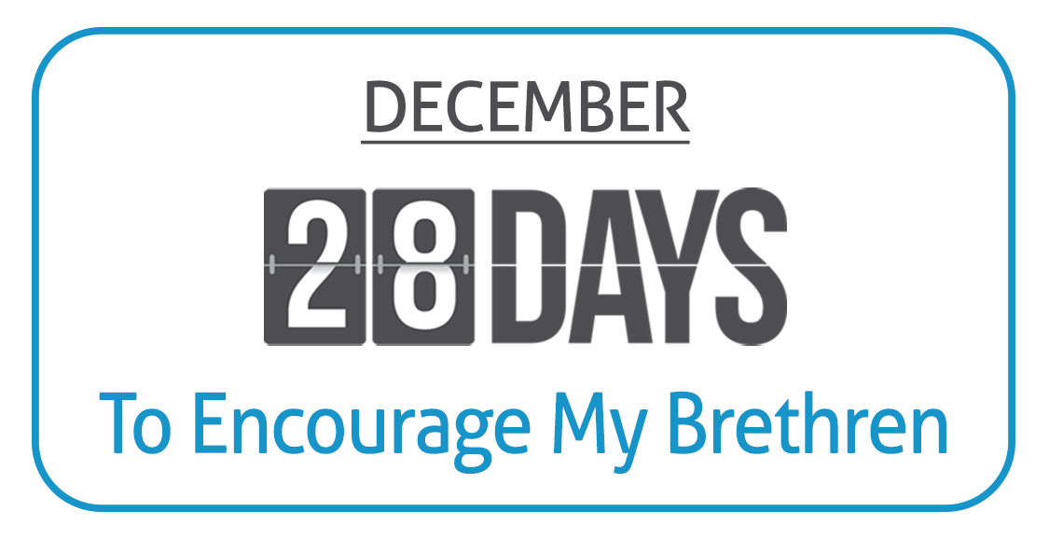

Slide 20
Send a note: “I’m glad that you’re my brother/sister in Christ!”
Seek to build someone up who is discouraged or overwhelmed
Express appreciation to an elder for his labors
Visit a widow or shut-in or elderly member in their home
Plan to be at worship and church services every time you can
Make a call: “I just wanted to see how you’re doing today”
Compliment someone who recently did a good job in the church
Invite someone to have lunch or coffee together
Lend a helping hand to someone in the church
Send a note: “I prayed for you today! May God bless you!”

Slide 21
Smile and give a warm hug to someone who has struggled lately
Express appreciation to someone who may rarely receive any
Share a Bible verse that means a lot to you and has helped you
Celebrate and congratulate an accomplishment someone enjoyed
Extend comfort or sympathy to someone suffering or lonely
Send a note: “I’m glad that we are part of the same church!”
Arrive early or stay late at worship to meet, greet and visit
Take a meal to someone who has been having a hard time
Express appreciation to someone who works for the church
Send a note of praise to a young person in the church

Slide 22
Invite someone to hang out or go somewhere together
Reach out to someone who always seems to reach out to others
Make a call: “I was thinking about you and praying for you today.”
Express appreciation for a kind act of service done to another
Let someone who is missing worship know he/she is missed
Invite others into your home for fellowship
Send a note of praise to a young parent in the church
Do a random (even little) act of kindness for a church member

Slide 23
Our Purpose: Call alongside and build up
(1 Thess. 5:11)
Our Procedure: In word and in deed
(1 John 3:18 + Prov. 12:25; 15:13; 16:24; 25:11)
Our Persistence: Daily and without delay
(Heb. 3:13)

Slide 24
You must believe Jesus is God’s Son – John 8:24
You must repent of your sins – Acts 3:19
You must confess your faith – Romans 10:9
You must be immersed into Christ – Romans 6:3
  God will forgive all of your sins – Acts 2:38
  God will add you to His “one another” – Acts 2:47
  God will register you in heaven – Hebrews 12:23
You must serve Him faithfully – Hebrews 3:12-15

