Slide 2
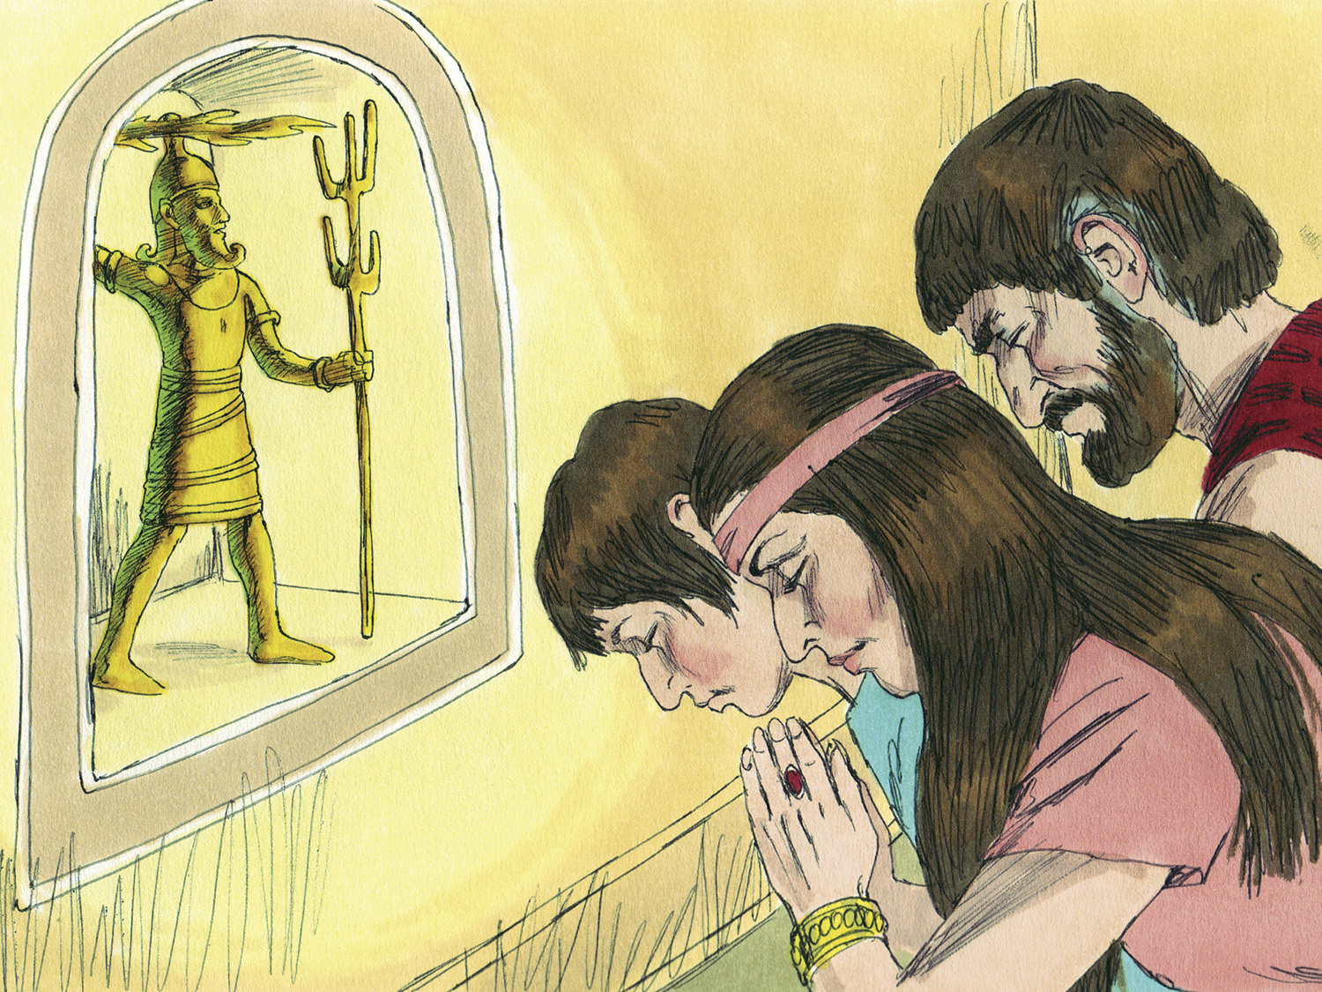

Slide 3
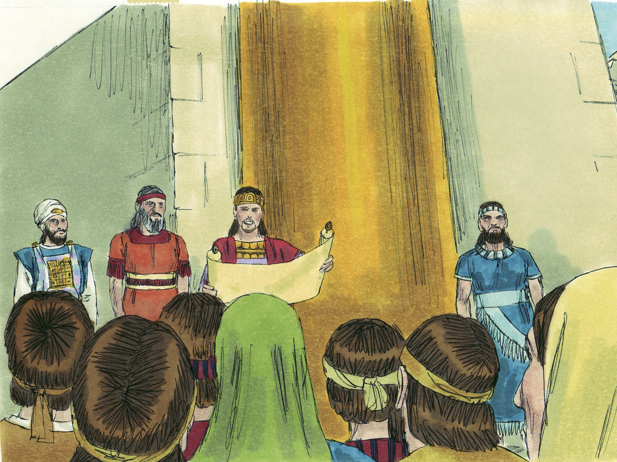

Slide 4
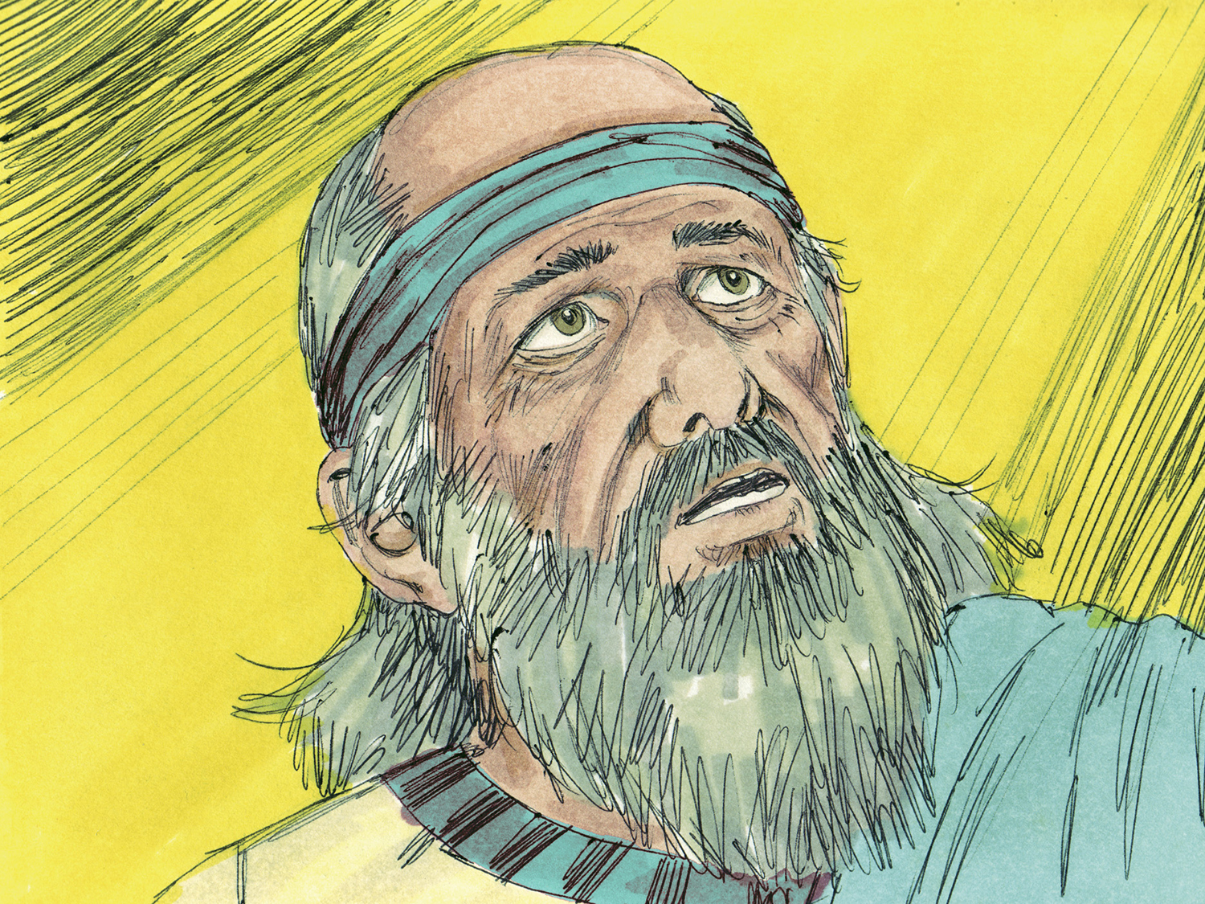

Slide 5
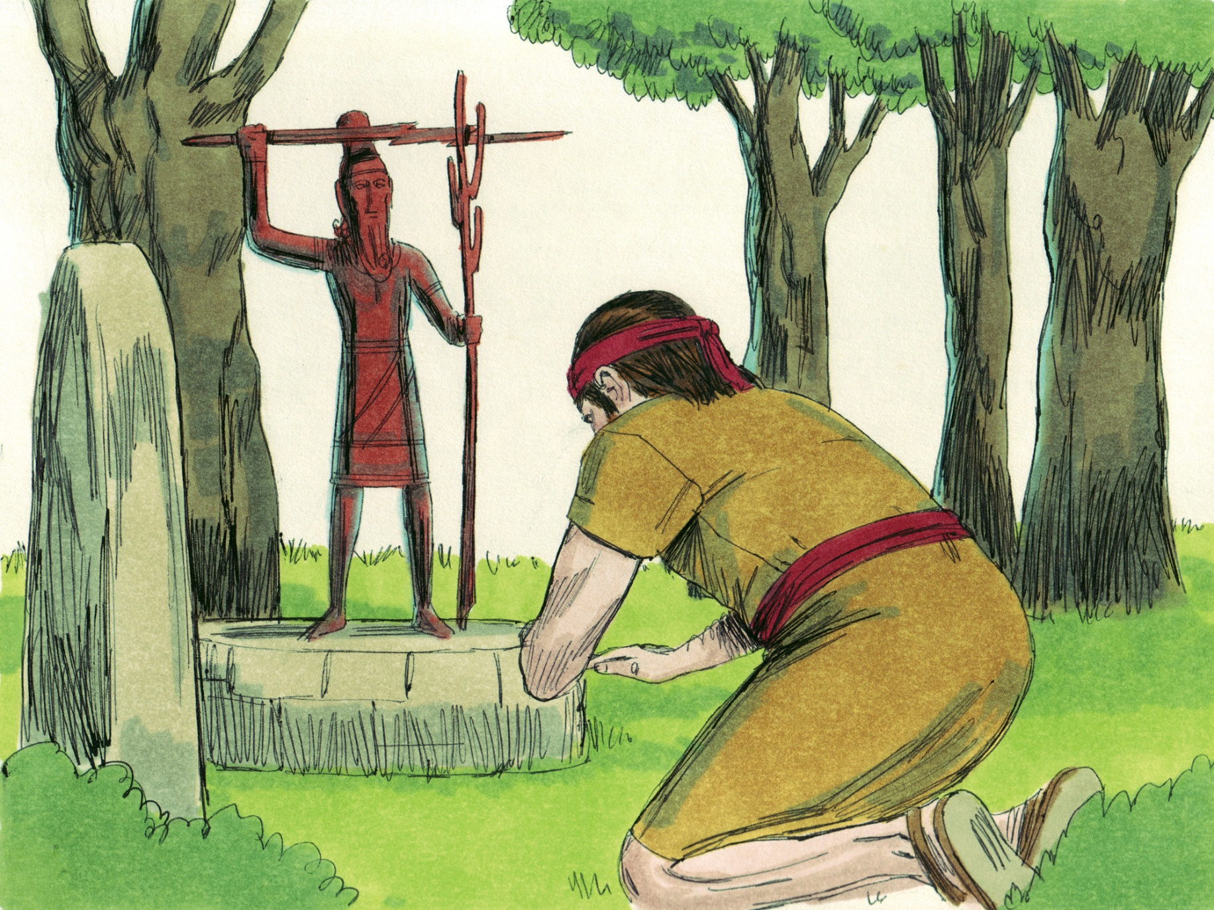

Slide 6
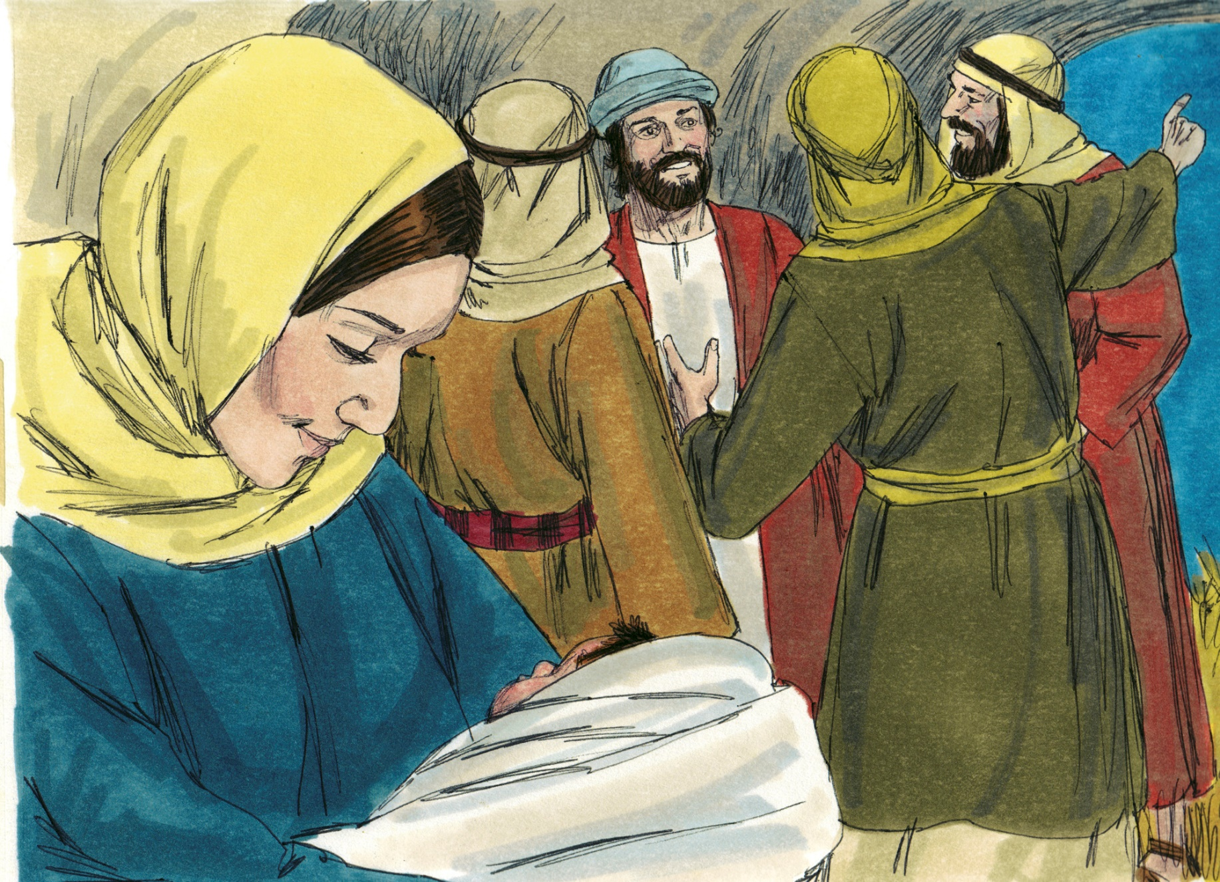
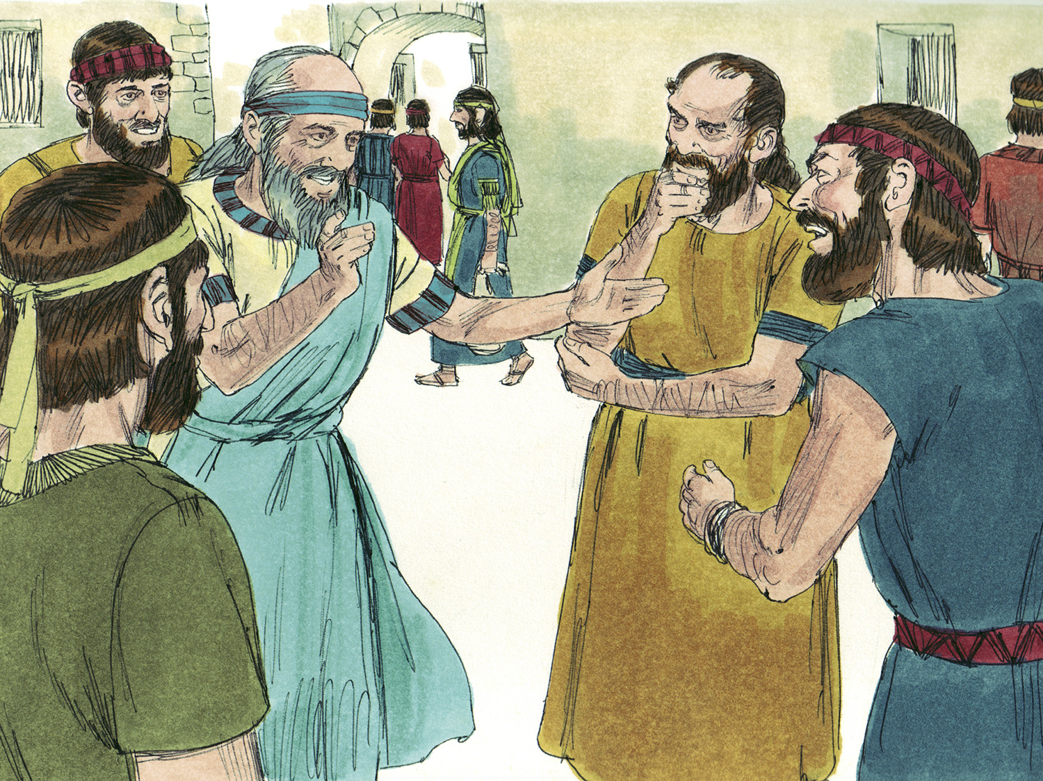

Slide 7
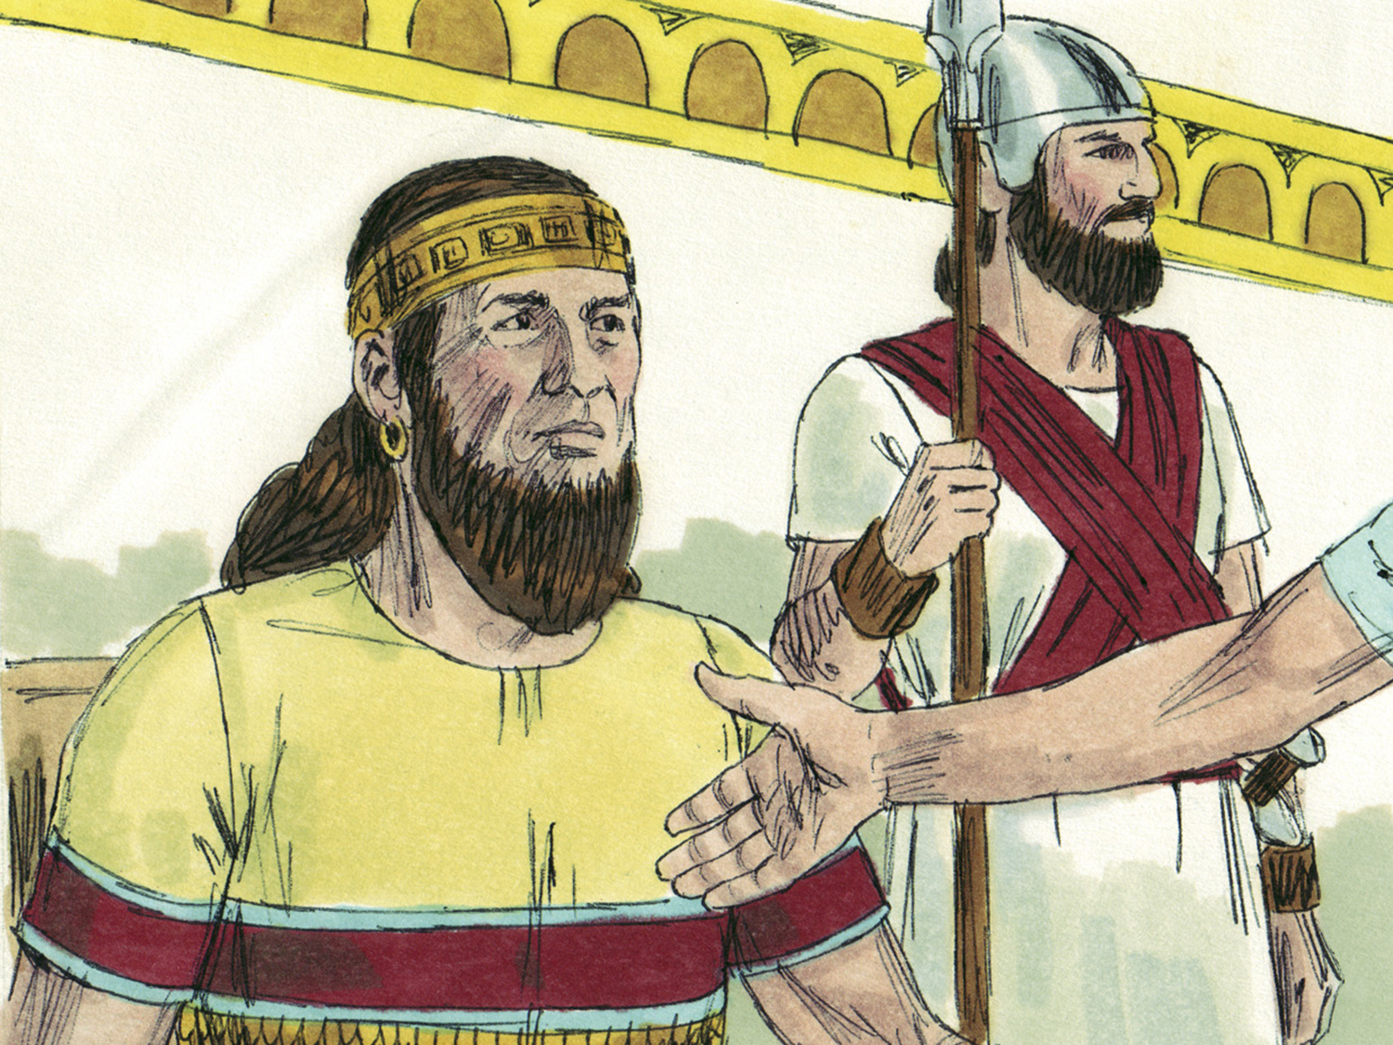

Slide 8
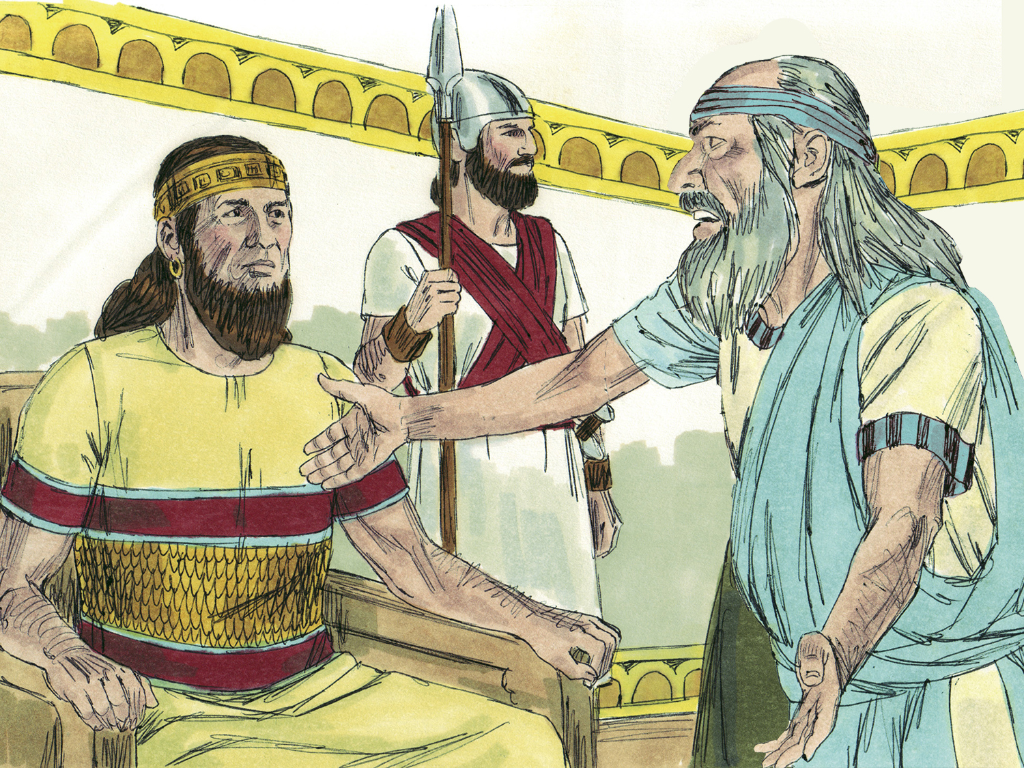

Slide 9
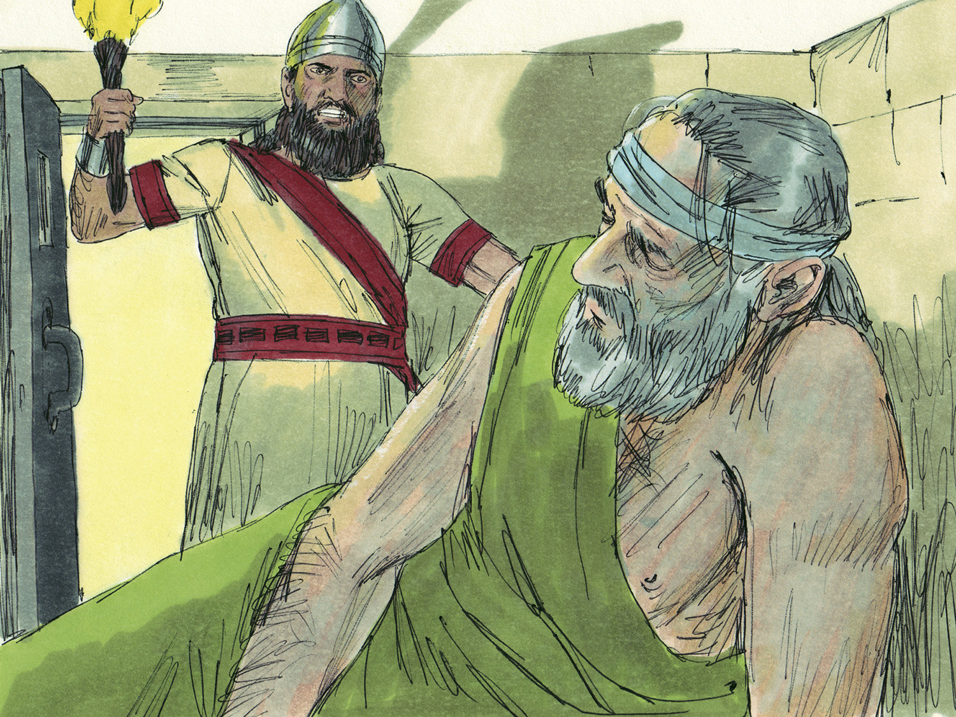

Slide 11
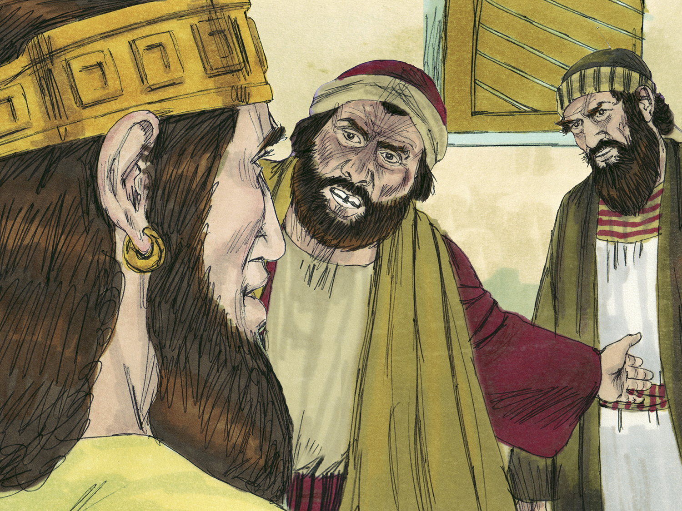

Slide 12
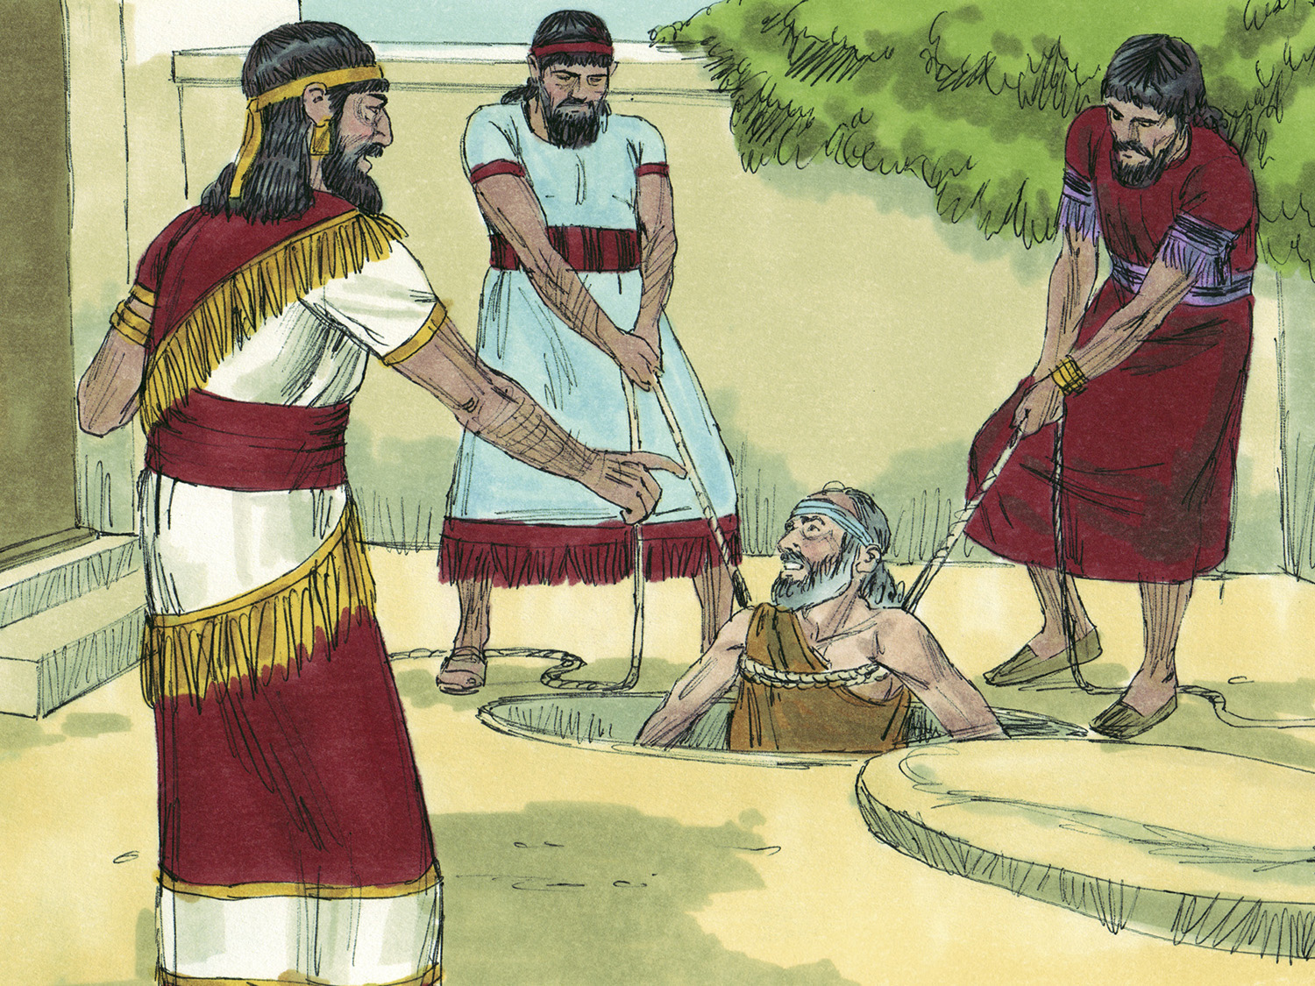

Slide 13
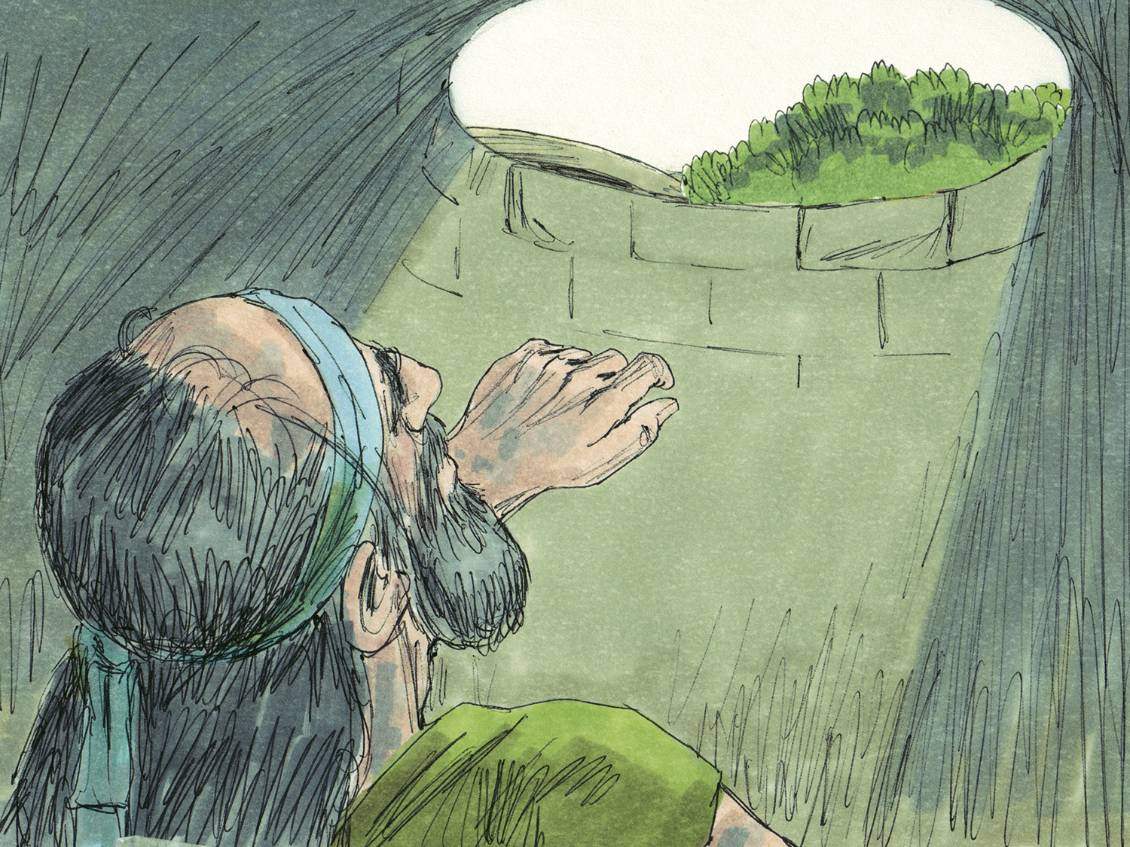

Slide 14
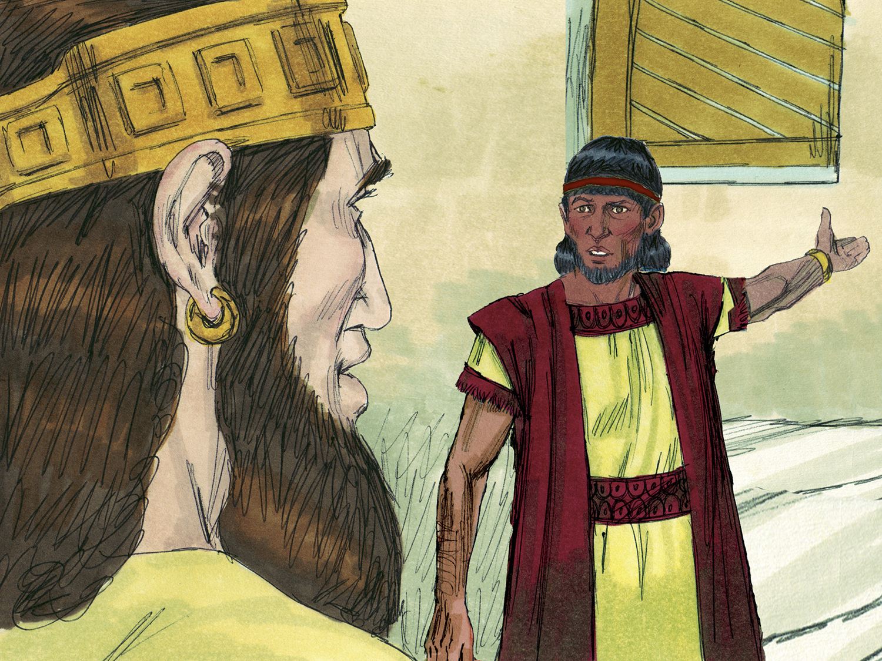

Slide 15
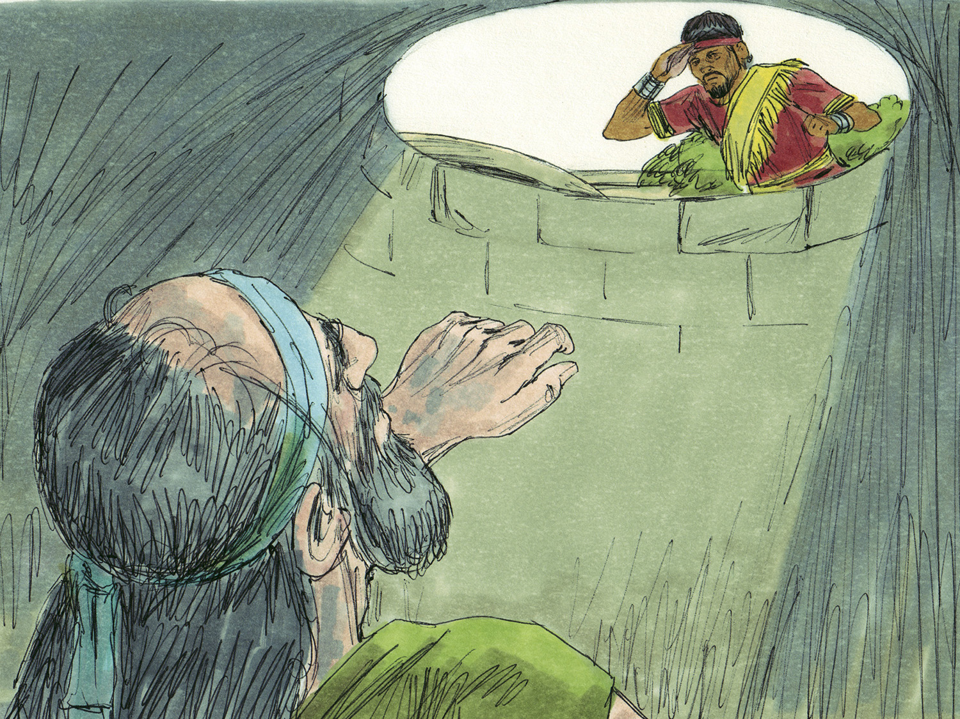

Slide 16
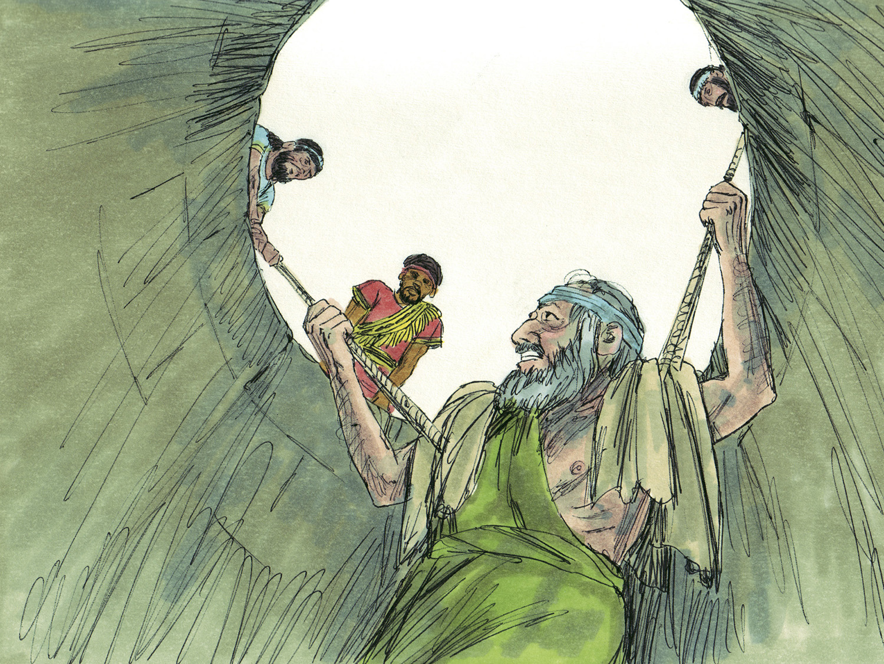

Slide 17
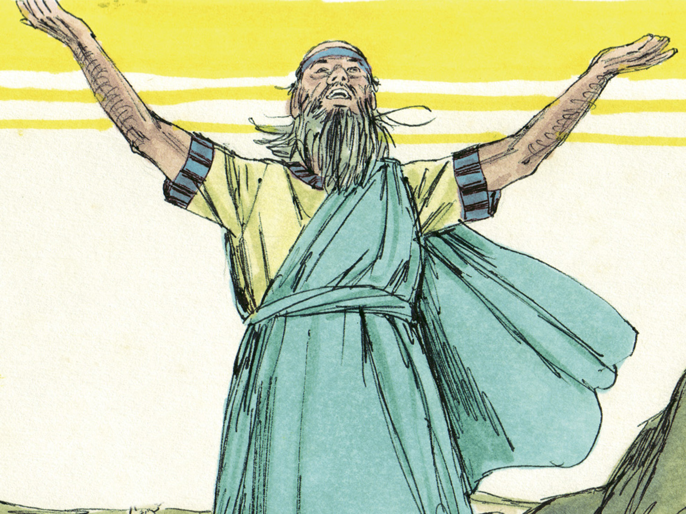

Slide 18
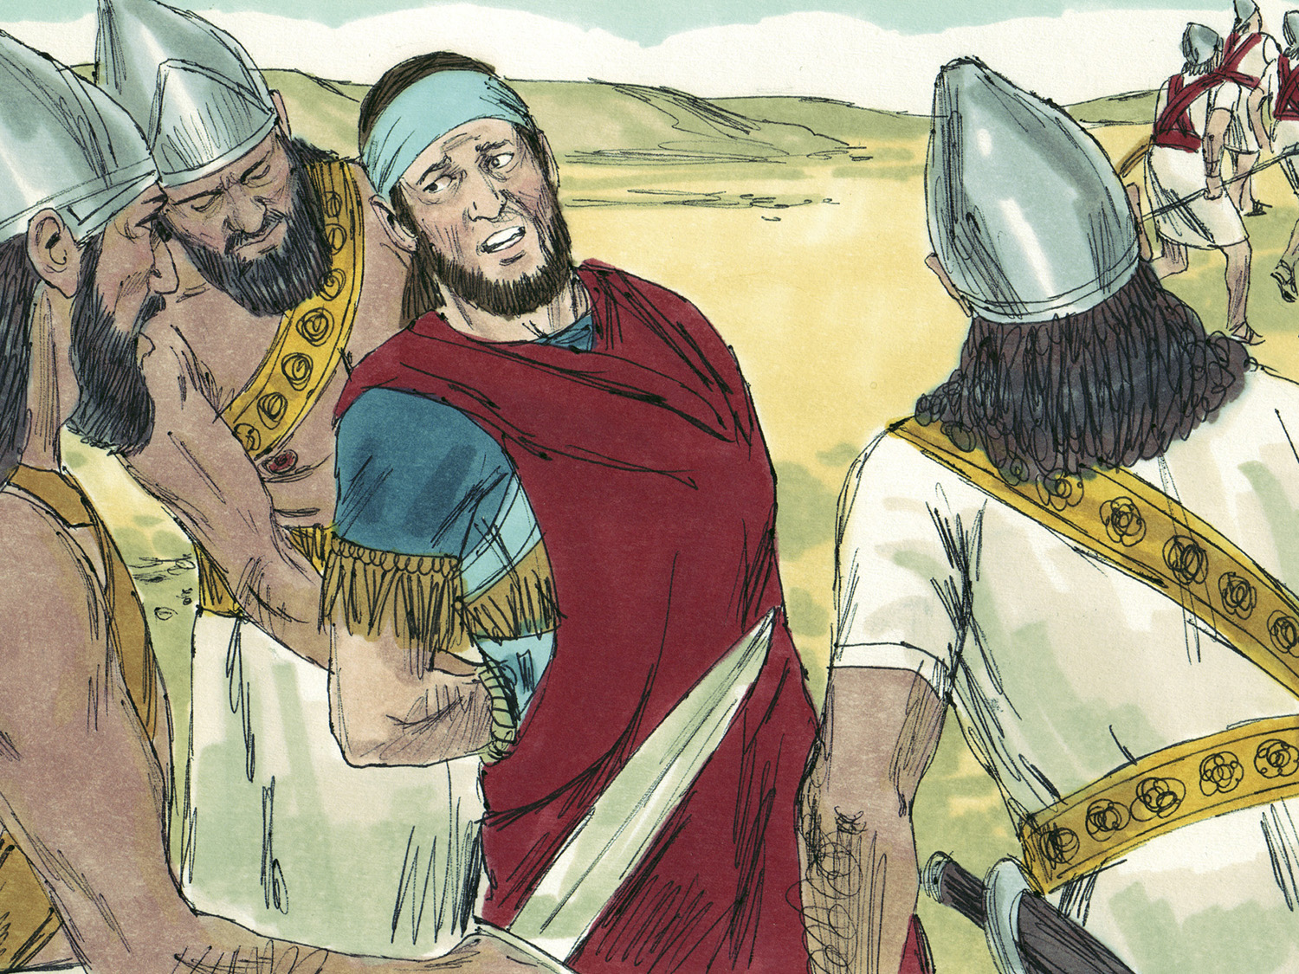

Slide 19
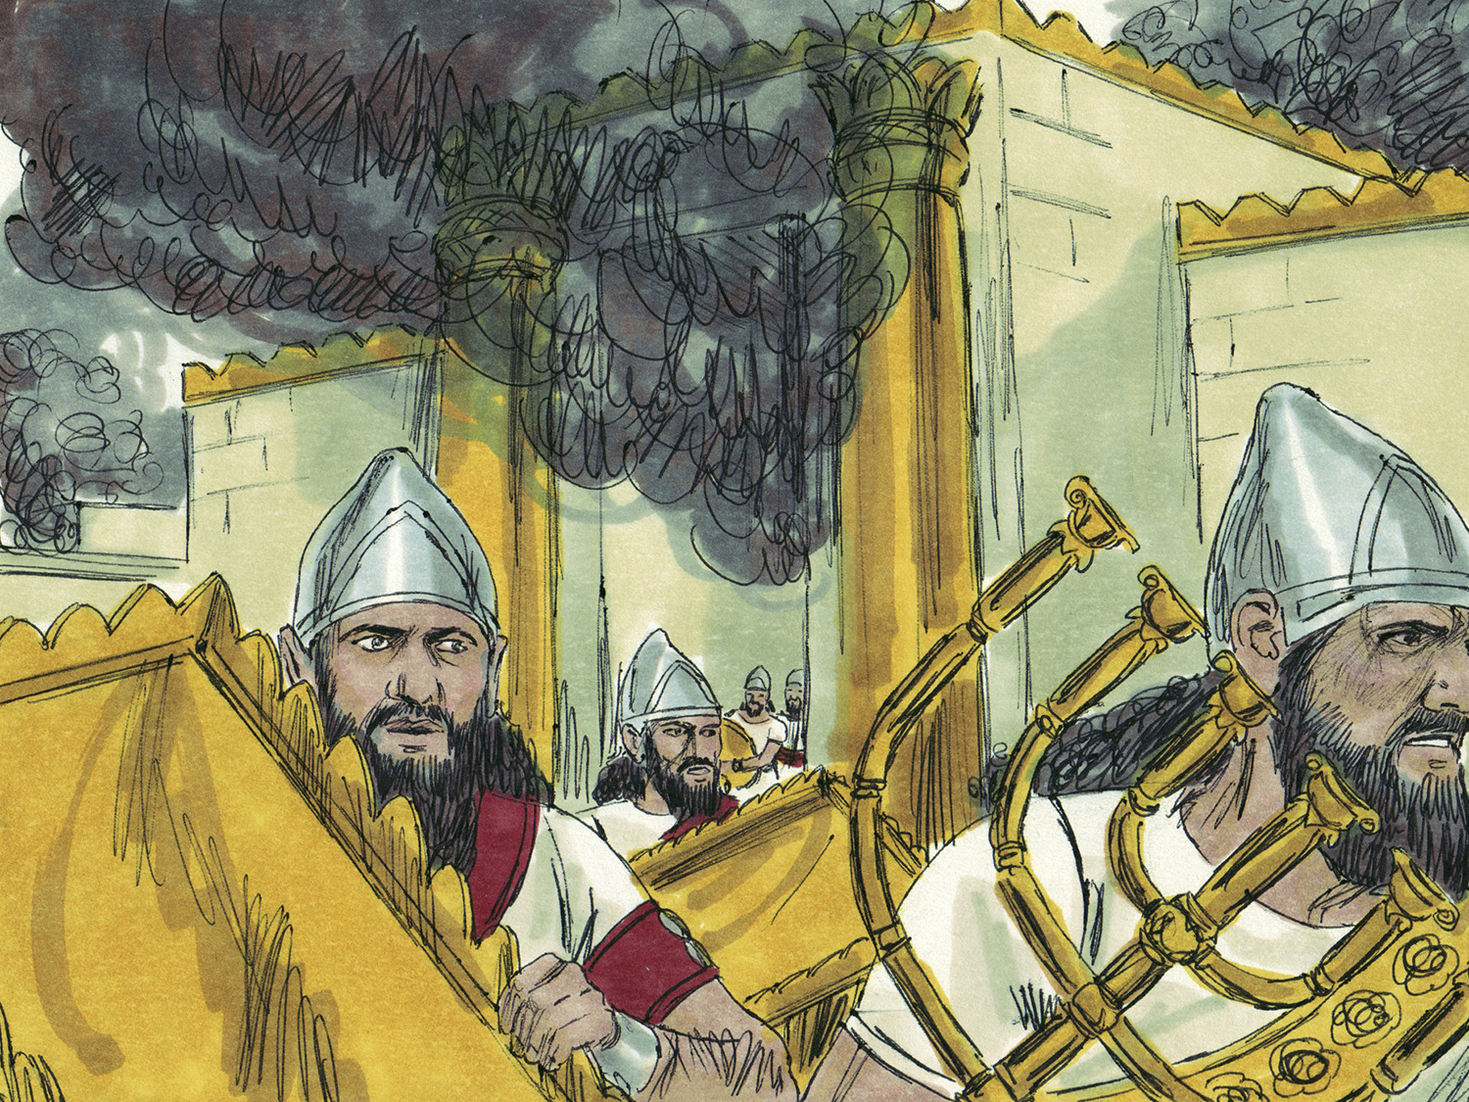

Slide 20
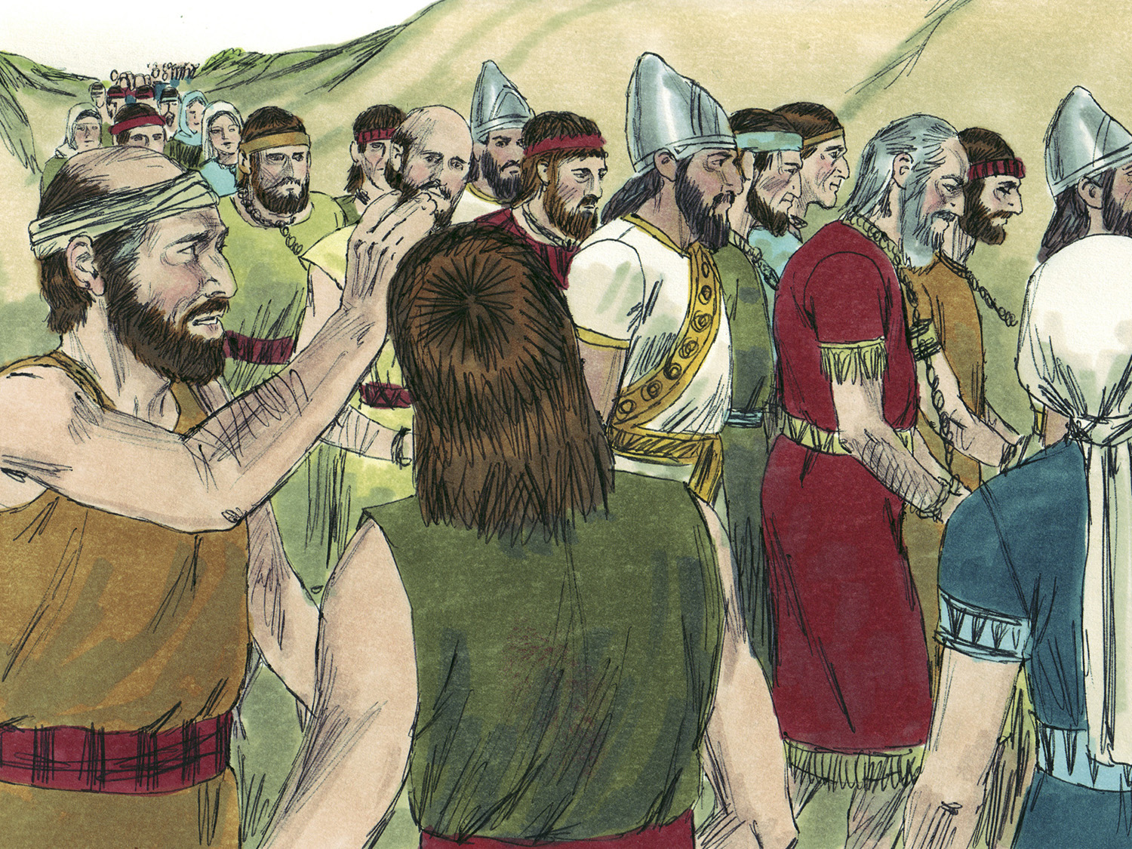

Slide 21
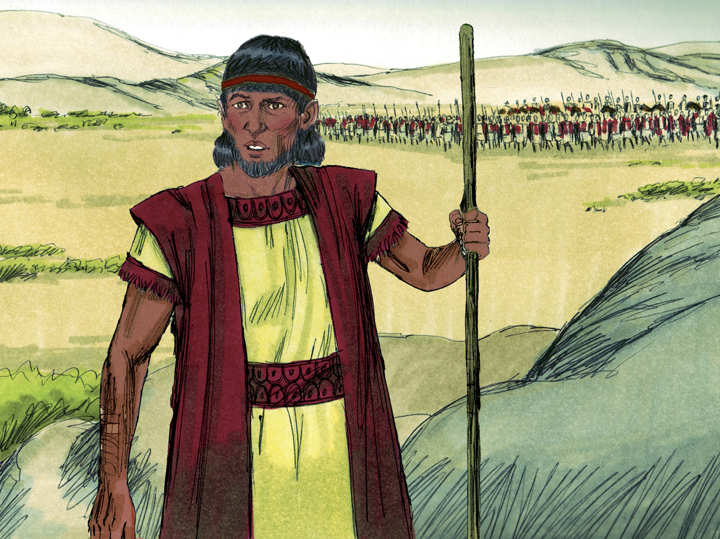

Slide 22
Refuses to see skin color (Jas. 2:9; Acts 17:24-28)
Refuses to be let one’s class/status define him (Acts 10:34-35; Gal. 3:28)
Moves one to act when no one else does or will (Jas. 4:17; 2:14-17; 1:22; Prov. 3:27-28; 1 John 3:18; Ecc. 9:10)
Knows no limits for an important message (Acts 4:20; 8:4; 9:15; Mark 16:15; Rom. 1:16)
Puts the well-being of another above self (Rom. 12:10; Phil 2:3-4, 29-30; 1 Thess. 2:8-9)
Labels evil as evil (Isa. 5:20; Matt. 7:1-20; John 7:24; Gal. 5:19-21; Eph. 5:11-13; Ezek. 3:17-21)
Knows the power is in God and not in man (Rom. 8:31; Eph. 6:10; 3:16-21; Psa. 18:1-2, 31-34)
Is divinely rewarded (Jer. 39:15-18; 1 Cor. 15:58; Rev. 2:10; Heb. 5:9)

Slide 23
Believe Jesus is God’s Son – John 20:30-31
Repent of your sins and turn to God – Acts 2:38
Confess your faith in Jesus – Romans 10:9-10
Be immersed into Christ – Galatians 3:27
  God will forgive all of your sins – Acts 22:16
  God will add you to His church – Acts 2:47
  God will register you in heaven – Hebrews 12:23
Serve the Lord faithfully – 1 Corinthians 15:58

